Slide 1
Nutrition Management For Kidney Stones
By
Aditi Shah MPH, RD – Registered Dietitian & Health Coach

Slide 2
Causes of Kidney stones
Dehydration
High Sodium Intake
High Doses of Vitamin C supplementation ( > 1000mg)
High Urinary Calcium- possible due to toxicity from high supplement intake or Vit D toxicity – levels > 150mg
High oxalates in the urine increases the risk of calcium oxalate kidney stones. Vitamin B6 deficiencies also increase levels of oxalates in the urine
Decrease in Urine PH levels
High Uric Acid Levels: Elevated uric acid is also associated with gout and cardiovascular disease & uric acid stones. High uric acid is most commonly seen with high fructose consumption.
“Its Most Important to Find out the cause of your kidney stone”

Slide 3
Types of Kidney Stones
Calcium Oxalate Stones
Uric Acid Stones
Calcium Phosphate stones
Cystine Stones

Slide 4
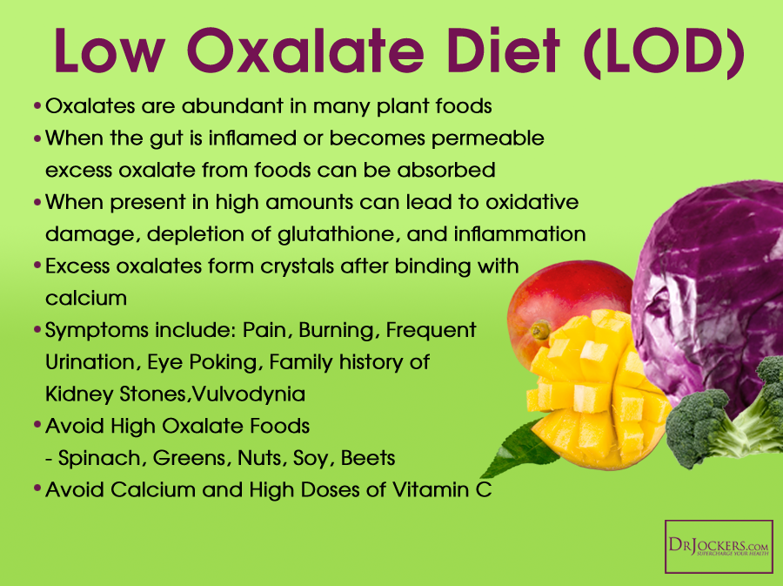
Calcium Oxalate Stones

Slide 5
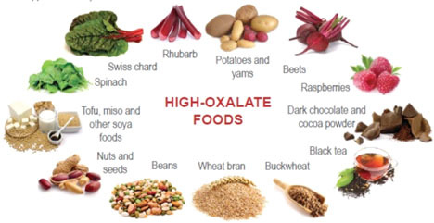
Limit High Oxalates foods

Slide 6
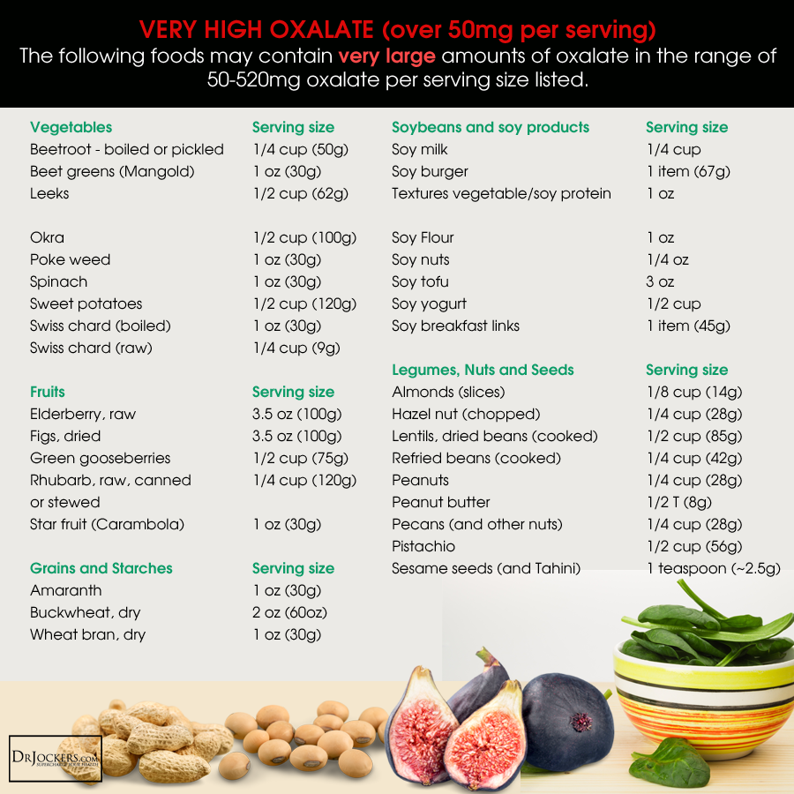

Slide 7
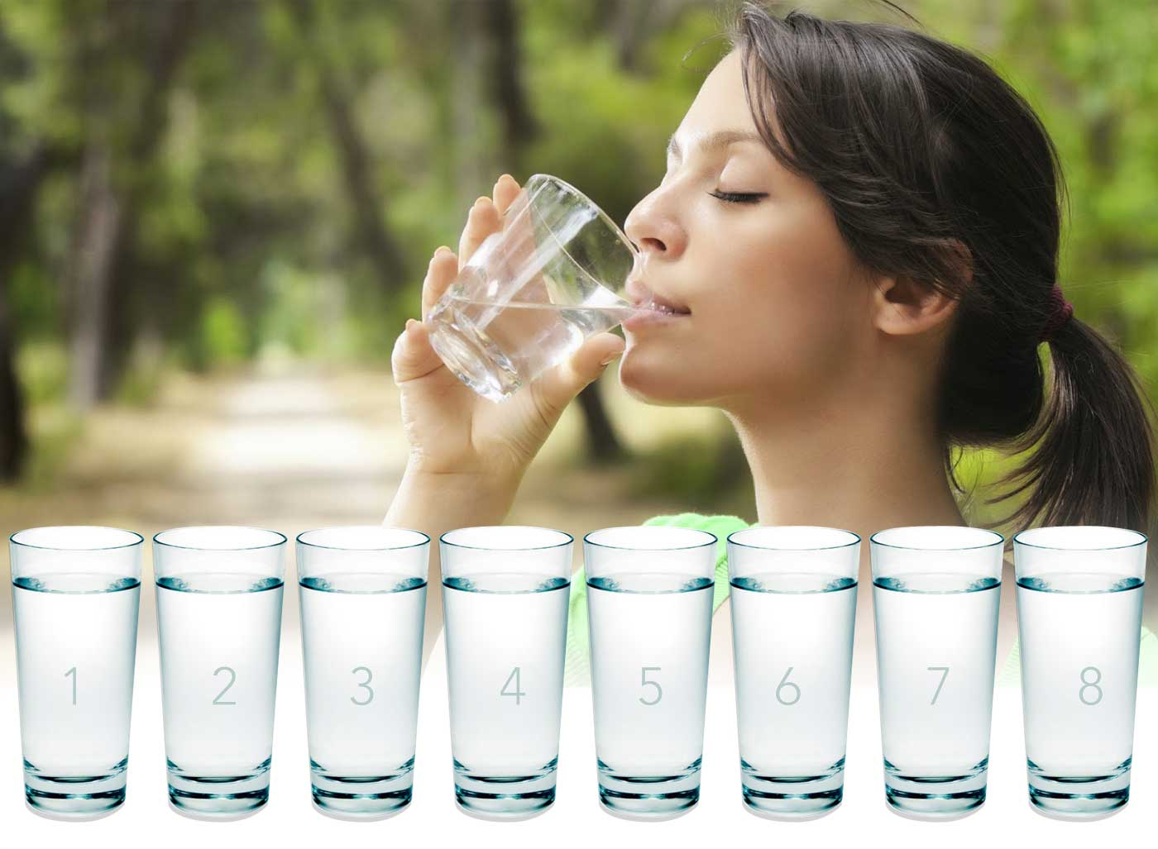
Fluid Intake
Drinking lots of water helps flush out toxins that accumulate in the kidney.
Drinking water is an excellent preventive measure to avoid formation of kidney stones.
Ensure plenty of fluids in take to prevent urine from becoming concentrated.
Drink at least 64-96 Oz of water/ day

Slide 8
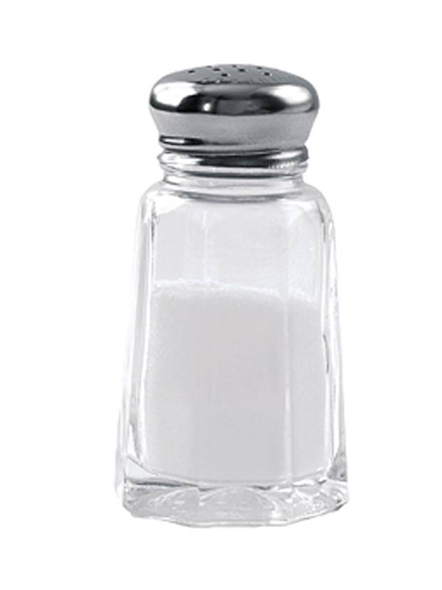
Limit Salt Intake
Reduce the amount of salt you eat
Aim for no more than 2500mg of salt / day
Avoid all processed foods.
Sodium, often from salt, causes the kidneys to excrete more calcium into the urine.
High concentrations of calcium in the urine combine with oxalate and phosphorus to form stones.
Reducing sodium intake is preferred to reducing calcium intake
Limit Dairy products intake to 2 serving per day of low fat products.
Include plant based protein sources- such Quinoa, lentils, pulses, dried beans- also low in oxalates

Slide 9
Getting Enough Calcium from Foods
Calcium from food does not increase the risk of calcium oxalate stones. Calcium in the digestive tract binds to oxalate from food and keeps it from entering the blood, and then the urinary tract, where it can form stones.
People who form calcium oxalate stones should include 800 mg of calcium in their diet every day, not only for kidney stone prevention but also to maintain bone density.
A cup of low-fat milk contains 300 mg of calcium. Other dairy products such as yogurt are also high in calcium.
For people who have lactose intolerance and must avoid dairy products, orange juice fortified with calcium or dairy with reduced lactose content may be alternatives.
Calcium supplements may increase the risk of calcium oxalate stones if they are not taken with food. Always take calcium supplements with meals,

Slide 10
Home remedies for oxalate Stones
Sprouted Green- May help reduce risk of kidney stones because sprouted grains have lower levels of phytic acid.
Lady Finger ( okra )- Helps bind excess toxins in bile acids and prevents crystallization of chemicals in the kidney.
Aloe Vera prevents deposition of free radicals and helps prevent formation of kidney stones. Regular consumption or aloe Vera juice helps in reducing kidney stones.
Radish Leaves - Soak leaves in water and leave them overnight. Drink the water twice a day, preferably morning and evening after removing the leaves. Juice extracted from the leaves and consumed are also just as effective
Red Apple is one of the best anti oxidant foods for effective dissolution of kidney stones.
Coconut water can be consumed several times a day for effectively treating kidney stones- by dissolving and flushing stones out.
  These remedies has been tried by many people, but research is be conducted to prove it’s remedial properties. Please consult your MD, prior to trying any home remedies, if you have any pre existing condition .

Slide 11
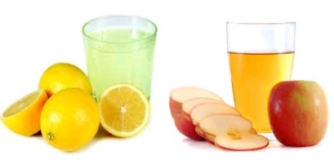
Add Fresh Lemon, Lime & Apple Cider Vinegar to Daily Beverages
Citric acid in lemon or lime - helps in effectively blocking the formation of kidney stones.
Add 1 tablespoon of apple cider vinegar to a glass of water and drink it every morning. This helps in breaking the kidney stones.
Lemon Juice is rich in Vitamin C, which makes it an excellent antioxidant. Mix two ounces of lemon juice and two ounces of olive oil and drink this mixture. Follow it up with a large glass of water. Drink about 10-12 glasses of water thorough out the day.

Slide 12
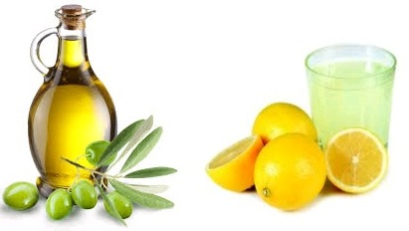
Lemon Juice & Olive Oil
Lemon Juice is rich in Vitamin C, which makes it an excellent antioxidant.
Mix two ounces of lemon juice and two ounces of olive oil and drink this mixture. Follow it up with a large glass of water. Drink about 10-12 glasses of water thorough out the day.
This remedy has been tried by many people, but research is be conducted to prove it’s remedial properties. Please consult your MD, prior to trying any home remedies, if you have any pre existing condition .

Slide 13
Low Purine Diet for Uric Acid Stones
Purine is natural substance that is found in mainly in animal protein foods
When body digest purine , it produces a waste product – Uric acid
Build up of uric acid crystals leads to kidney stones and also leads to gout.
Foods to limit on low purine diet- legumes, beans, high fat foods.

Slide 14
Low purine Foods
Rely on plant based proteins- ( myth that beans are high in uric acid)
Eat several servings of fiber rich plant foods- such as whole grains , vegetables & fruits
Minimize intake of refined carbohydrates ( white products, sugar, high fructose corn syrup)
Drink 2-3 L of water/day
Maintain Healthy Body weight

Slide 15
Home Remedies for Uric acid stones
Include Lemons & limes in your diet
Include all berries, apples, bananas in your diet- due to anti oxidant & anti inflammatory properties
Include vegetable juice- such as celery, cucumber, beets and carrots – have very beneficial effects.
Foods rich in Vitamin C for Uric Acid • Include Vitamin C rich foods and supplements in your daily diet to reduce uric acid in the body. It disintegrates uric acid and forces it out of the body through urine.
Good sources of vitamin C are Amla, Guava, Kiwi, Sweet lime, oranges, capsicum, lemon, tomato and green leafy veg.

Slide 16
Eating grains that are more alkaline such as Jawar, Bajra are helpful to reduce the level of uric acid in the body.
Drink apple cider vinegar. Add 3 teaspoons of vinegar to 8 ounces of water and have it 2-3 times every day to treat uric acid.
Celery Seeds for Uric Acid • This is a popular home remedy to lower uric acid levels in the body. Have celery seeds extract to get best results.
These remedies has been tried by many people, but research is be conducted to prove it’s remedial properties. Please consult your MD, prior to trying any home remedies, if you have any pre existing condition .

Slide 17
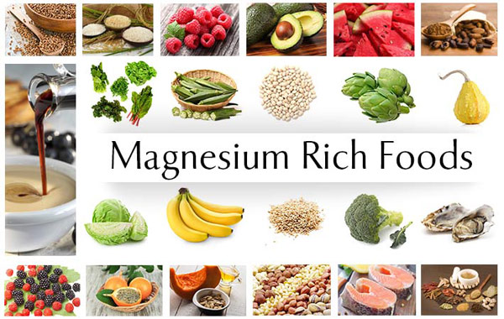
Magnesium for Kidney Stones
Intake of foods rich in magnesium is very helpful in preventing formation of kidney stones and in dissolving existing stones. Foods like banana, brazil nut, strawberry, artichoke, low fat yoghurt, pumpkin seeds, soybeans, black tea, cashew and pine nut can be added to the diet for better results in dissolving kidney stones naturally.

Slide 18
Thank You

